Slide 1
PROGRAMS and SERVICES achieved
Philippine St. Francis of Assisi Deaf Center, Inc.
Fr. Hozo Sato, OFM
Director

Slide 2
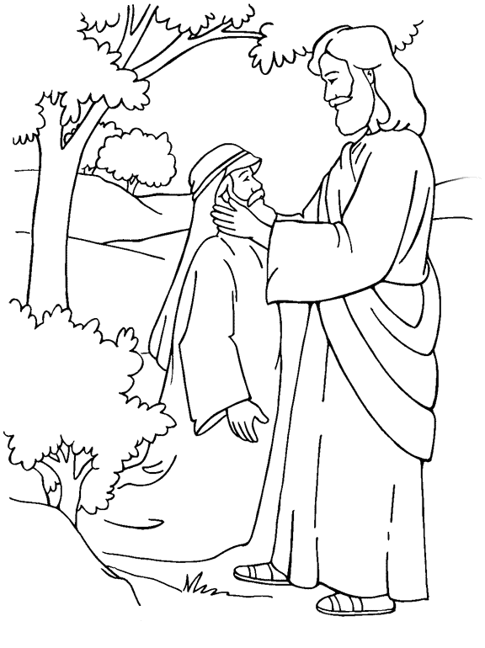
“ for the Deaf
and
by the Deaf…..”

Slide 3
To provide the educational needs and access to transportation from home to school.
To provide accommodation and basic necessities to those who urgently need it.
To initiate self-developmental activities that will enhance the skills and capacities of the Deaf.

Slide 4
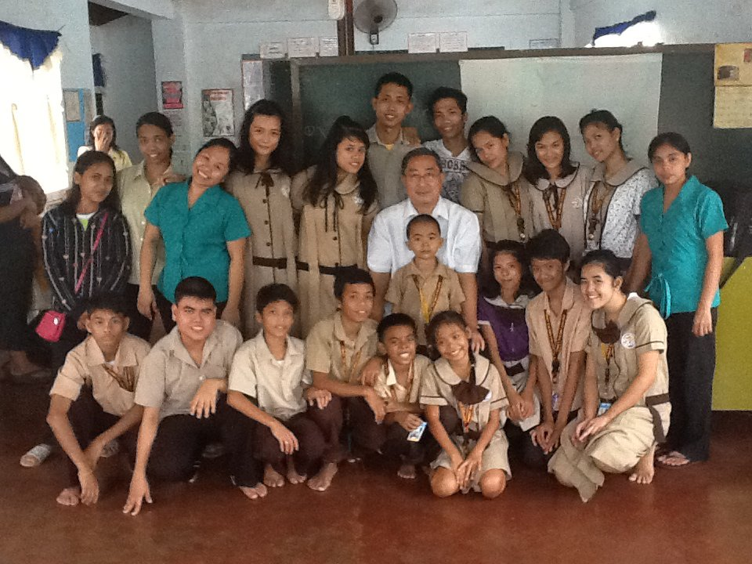
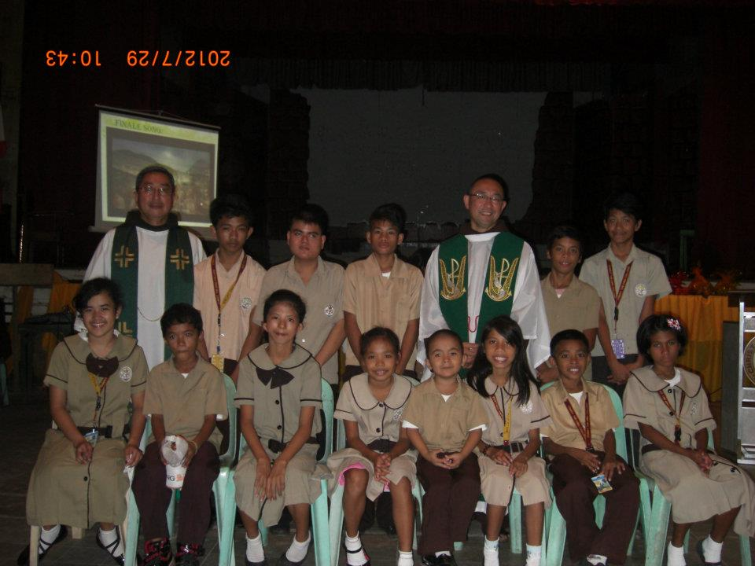
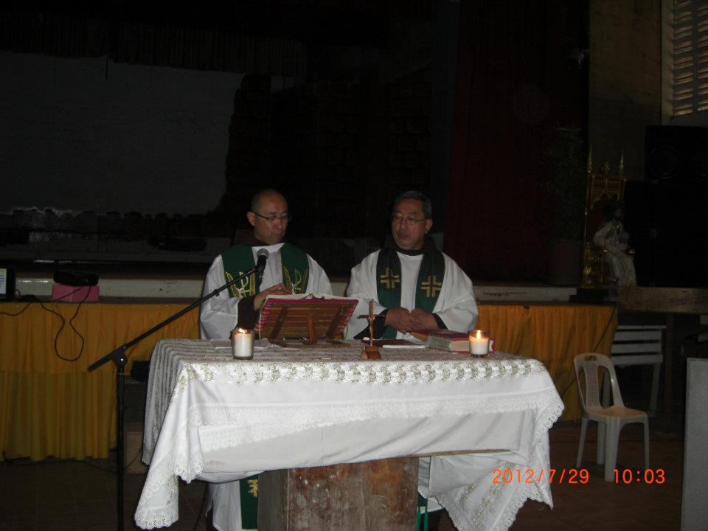
Fr. Abe, ofm visitation

Slide 5
Scholars have fun in learning..

Slide 7
Wishing you the timeless treasures of Christmas. The warmth of home, the love of family and the company of good friends.

Slide 8
Literacy Class for the Deaf
Aims to develop Deaf child’s basic communication skills and o initiate basic behavioral characteristic building activities.

Slide 9
Catholic Organization of the Deaf
Adults and Youth

Slide 10
SUPPORTS DEAF COMMUNITY ACTIVITIES and SERVICES

Slide 11
Aims to give awareness and attention to public as well as to social media to support the Deaf concerns, problems and issues.

Slide 12
“I hope your dreams take you... to the corners of your smiles, to the highest of your hopes, to the windows of your opportunities, and to the most special places your heart has ever known.” - Author Unknown

Slide 14
T
H
I
N
C
L
I
E
N
T
S
Y
S
T
E
M
S
E
R
V
E
R

